Slide 1
Public Hearing on the
2023-2024 Budget
June 20, 2023

Slide 2
Agenda
2023-2024 Budget Development
2023-2024 Budget for Adoption
Discussion on Property Values
Next Steps
Questions

Slide 3
2023-2024 Budget Development
The overall 2023-2024 budget supports the Commitments, Vision and Mission of Red Oak ISD Strategic Plan
The budget has been prepared in accordance with District policy and conforms to Texas Education Agency requirements
Both the revenue and expenditures have been reviewed and projected based on the data elements available at this time

Slide 4
2023-2024 Budget Development
Development process shared with the Board in January
Met with all Budget Managers (principals and department heads) in February
Campuses and Departments were provided their budget allocations in March to develop their 2023-2024 budgets
  Campus budgets are based on a per pupil allocation
  Department budgets are based on prior year budgets

Slide 5
2023-2024 Budget Development
Preliminary Property Values were received on April 30, 2023
  Initial 26.01% increase over the 2022 Certified Values
Budget Update was provided to the Board on May 15, 2023
The Tax Rate for adoption will not be presented to the Board until August or September
  The Proposed M&O Tax Rate is 0.8538 (a 9.45% reduction)
  The I&S Tax Rate will remain the same at 0.3481
  TEA will calculate the final M&O Tax Rate in late July

Slide 6
2023-2024 Budget Development
Revenue Assumptions
  100 increase in student ADA from the 2022-2023 budgeted ADA
    Used 93.25% of the projected 2023-2024 Fall Snapshot Enrollment of 6,809
    October 2022 enrollment was 6,499 (was projected to be 6,580)
  A 3% increase in the actual 2022-2023 enrichment student categories
    Most enrichment categories were comparable to the 2022-2023 budget
  The Basic Allotment remains at $6,160
  Due to the projected increase in Comptroller’s property values (PVS), the projected state aid will decrease
    District’s local share has increased, so the state share will go down
    Projecting a 21.5% increase in the Comptroller’s property value study

Slide 7
2023-2024 Budget Development
Revenue Assumptions
  District is eligible for the Fast Growth Allotment next year
    New legislation in 2021 changed the determination to a six (6) year lookback and a growth of at least 250 students over the six (6) years
      Red Oak growth was 689 students, so 439 counts towards the formula
  Current Tax collections based on a 21.6% increase in certified values
    Certified Values projected to be lower than the initial estimate due to protests
    Tax collections based on the current State MCR floor of $0.8538
      Factoring in the current Homestead Exemption of $40,000
  Increase the Safety Allotment to $10 per ADA and $15,000 per campus
  Projected increase in the State’s TRS pension payment

Slide 8
2023-2024 Budget Development
Expenditure Assumptions
  Compensation Plans
    Each step on the Teacher Salary Schedule will increase by $1,500
    Teachers will move up to the next step on the Teacher Pay Scale
      Teachers above the new step 30 will receive a longevity Stipend of $1,000
    Auxiliary/paraprofessional (non-exempt) employees are budgeted to receive 5% of the midpoint salary of their respective pay scale
    Administrative/Professional (exempt) employees are budgeted to receive 3% of the midpoint salary of their respective pay scale
    Continue to review the pay plans to ensure all pay grades are competitive

Slide 9
2023-2024 Budget Development
Expenditure Assumptions
  Positions added for the expansion of required programs
    Add 3 elementary positions due to student growth
    Add 1 teacher and 1 para to continue expanding Pre-Kindergarten to full day
      This will be based on Pre-K student growth
    Special Education Program
      1 Speech Language Pathologist due to the increase in referrals
      1 Licensed Psychologist due to the growth in caseloads
    Add 1.5 Middle School teachers due to student growth
    Add 2 teachers and 1 para at DAEP
    Add an additional counselor to be split between DAEP and the Middle School

Slide 10
2023-2024 Budget Development
Expenditure Assumptions
  Other positions
    An additional Security Guard at the High School
    2 more full-time substitutes at the secondary level
  Increase in property and liability insurance due to market conditions
  Increase in the Ellis County Appraisal and Tax Collection costs
  Sustain the attendance incentives previously implemented
  Increase the overall substitute budget
  Increase the security budget for additional canine visits and overtime

Slide 11
Agenda
2023-2024 Budget Development
2023-2024 Budget for Adoption
Discussion on Property Values
Next Steps
Questions

Slide 12
2023-2024 Budget Overview

Slide 13
General Fund Budget Overview

Slide 14
General Fund Budget Overview

Slide 15
General Fund Budget Overview

Slide 16
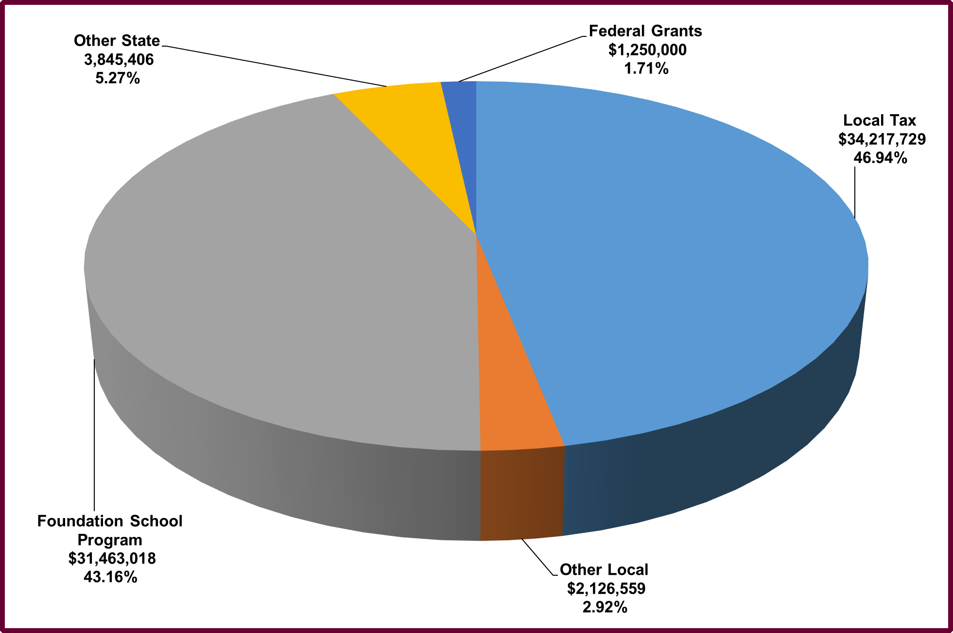
General Fund Revenues

Slide 17
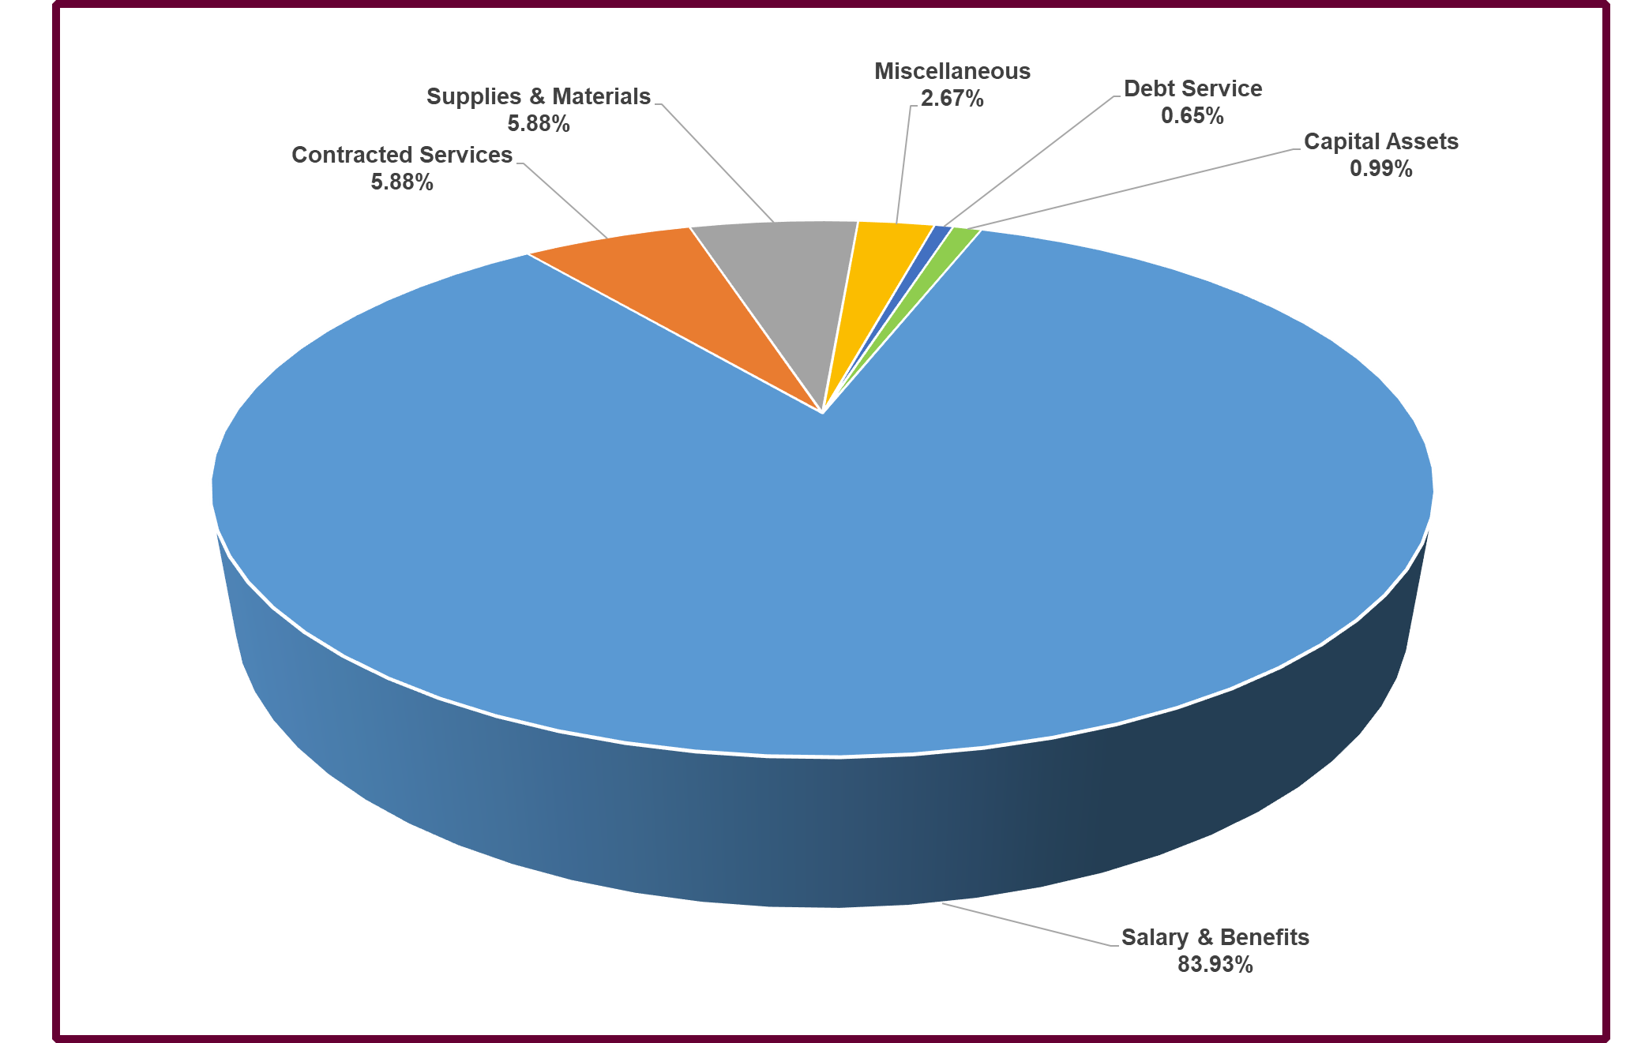
General Fund Expenditures by Object

Slide 18
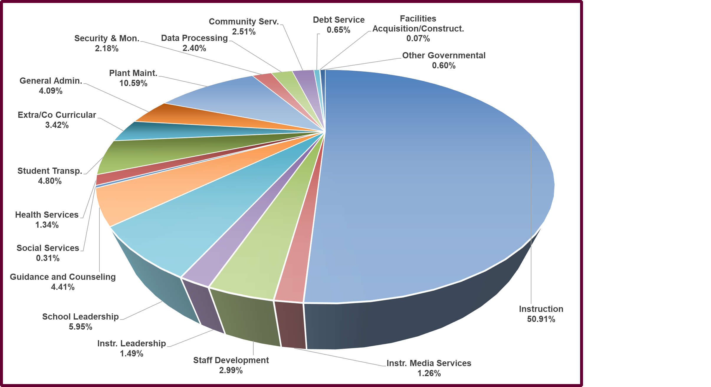
General Fund Expenditures by Function

Slide 19
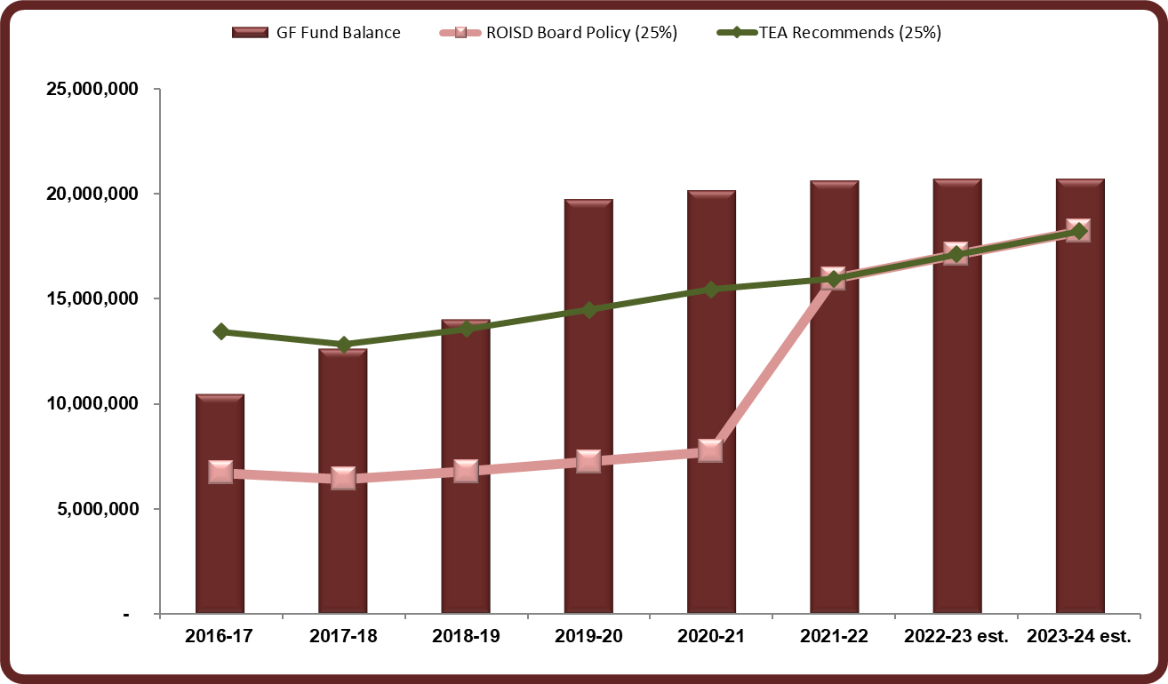
General Fund Balance History

Slide 20
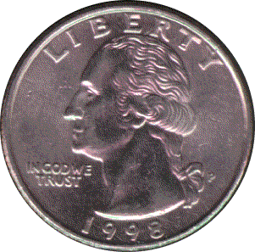



Where A Dollar Goes
71¢ is spent on teaching, transporting, supervising and counseling students
6¢ is used for library materials, staff training and curriculum development
13¢ goes toward securing, operating and maintaining facilities
10¢ goes toward central, fiscal, IT & community services

Slide 21

Student Nutrition Fund

Slide 22
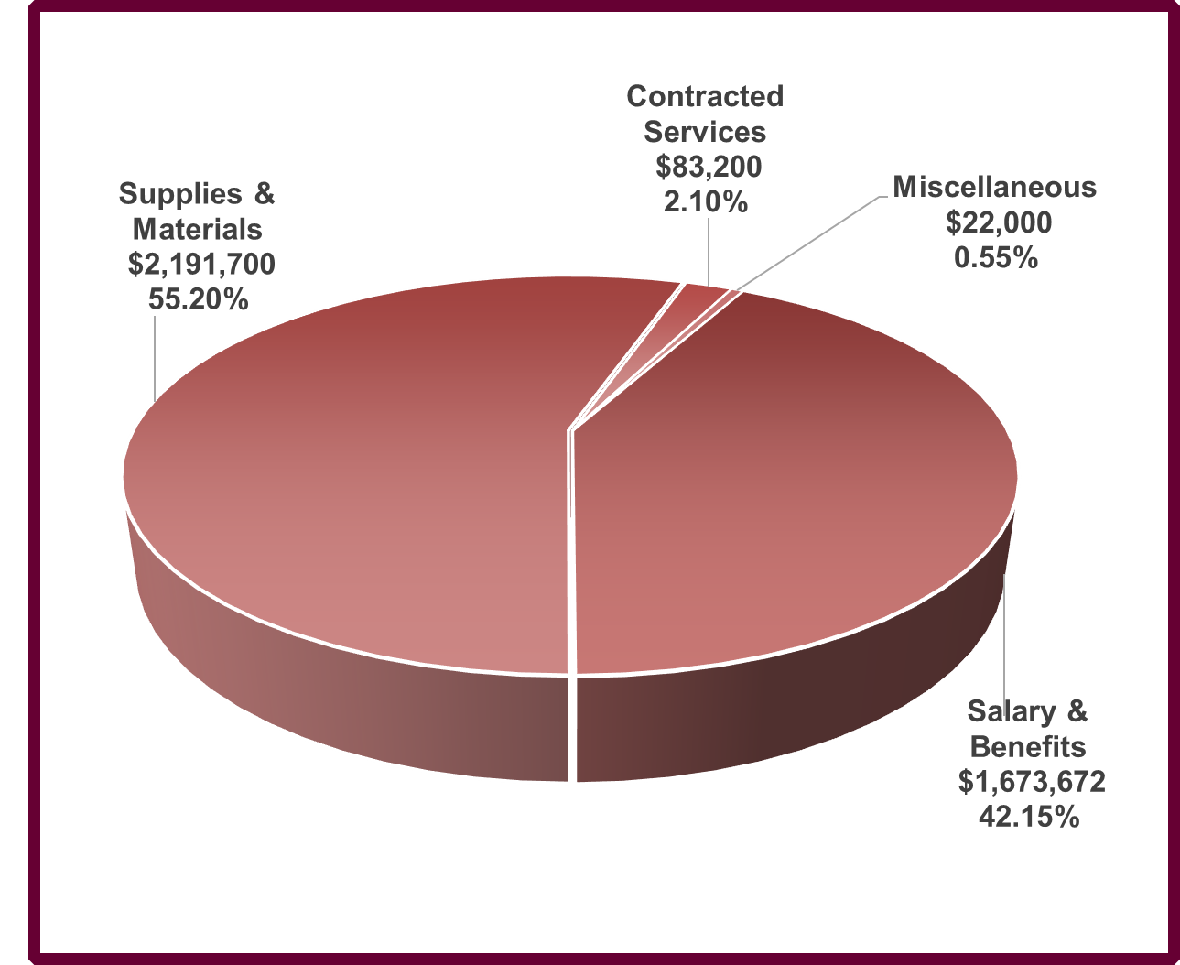
Student Nutrition Fund

Slide 23
Debt Service Fund

Slide 24
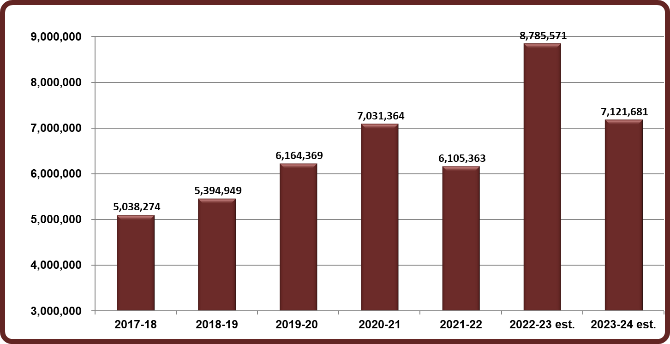
Debt Service Fund

Slide 25
Additional Budget Data
Supporting Information
  Student Enrollment
  Average Daily Attendance (ADA)
  Weighted Average Daily Attendance (WADA)
  Revenue Per WADA
  Property Taxable Values
  Estimated Tax Collection for 2023-2024
  Tax Collection History
  Historical Tax Rates
  Top 10 taxpayers in Red Oak

Slide 26
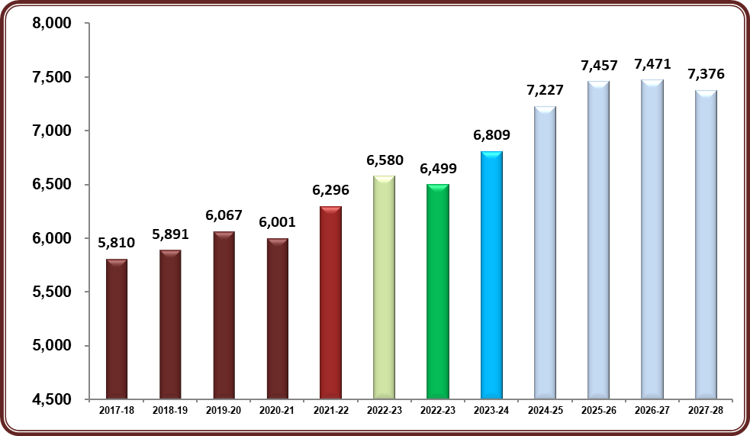
Student Enrollment

Slide 27
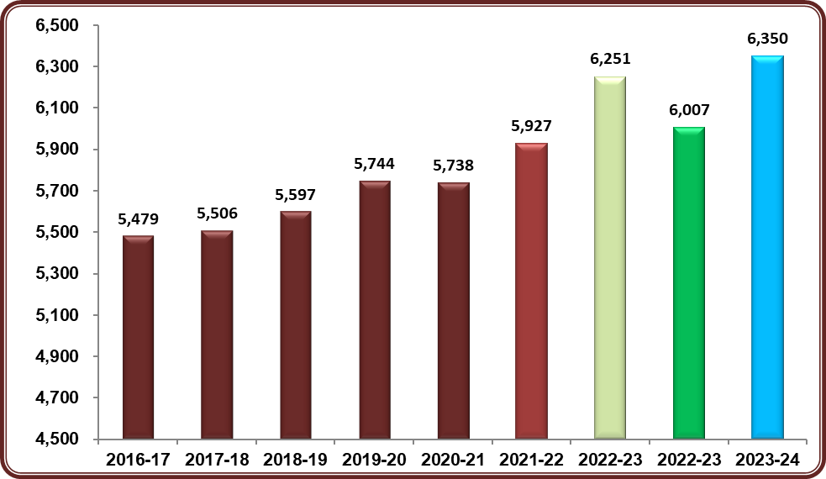
Average Daily Attendance

Slide 28
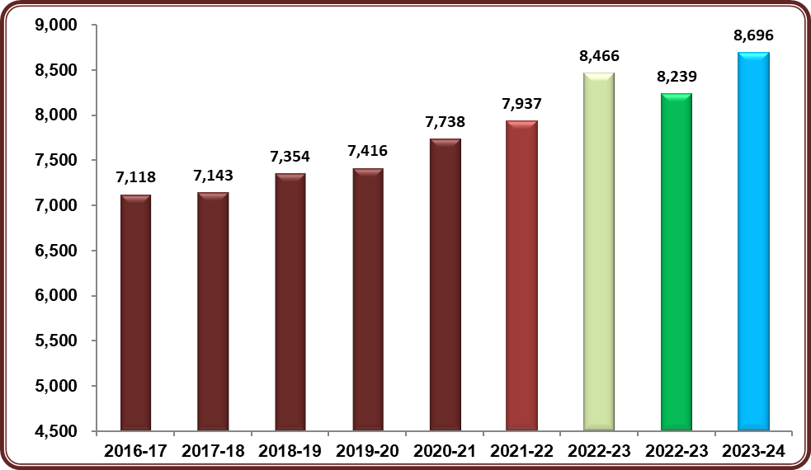
Weighted Ave Daily Attendance

Slide 29
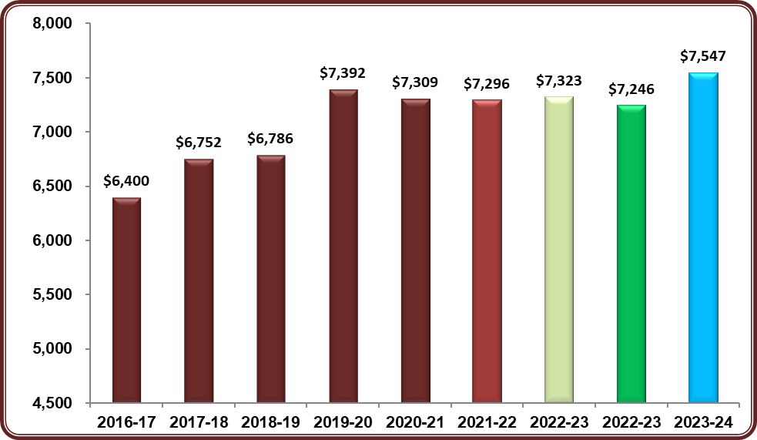
Revenue Per WADA

Slide 30
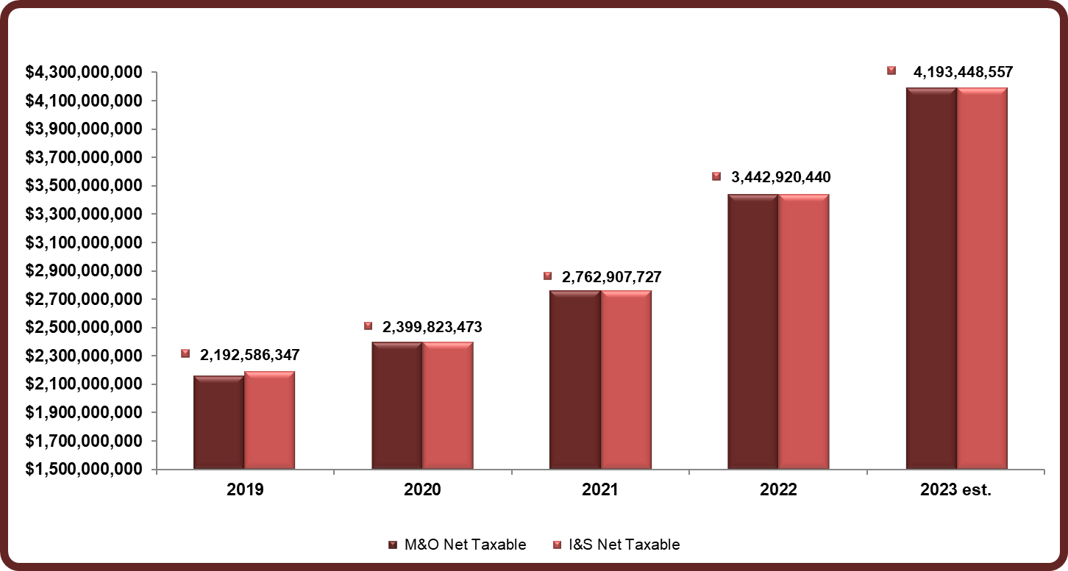
Taxable Values

Slide 31
Estimated Tax Revenue

Slide 32
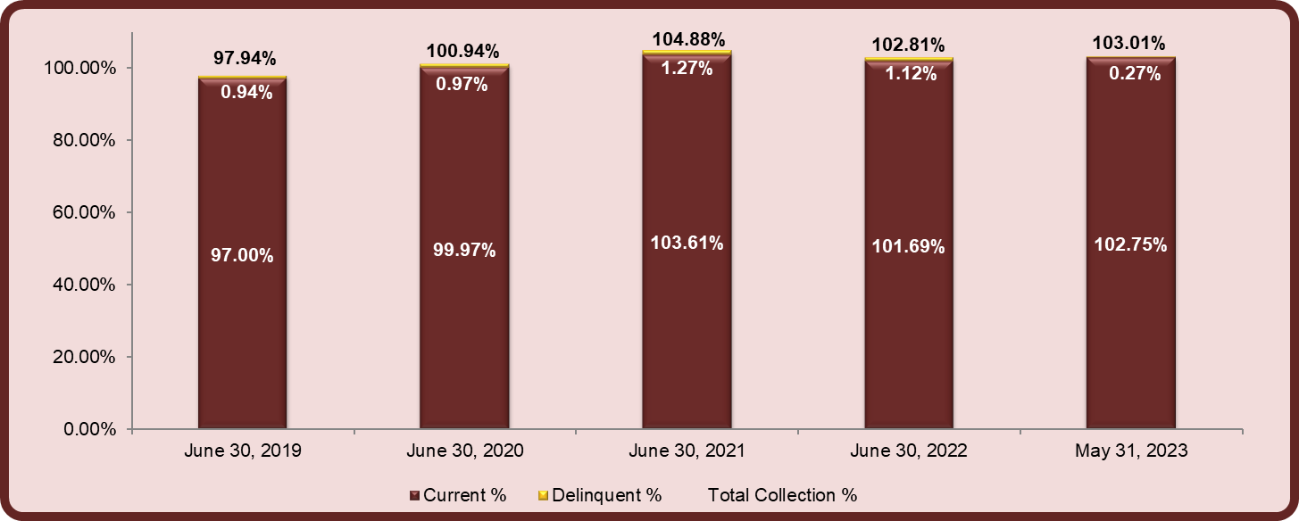
Tax Collection History

Slide 33
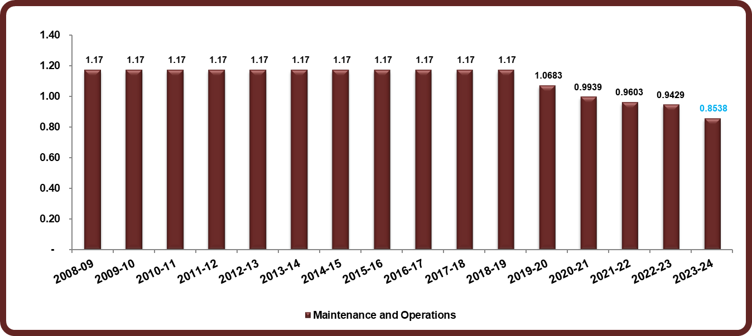
Tax Rate History (M&O)

Slide 34
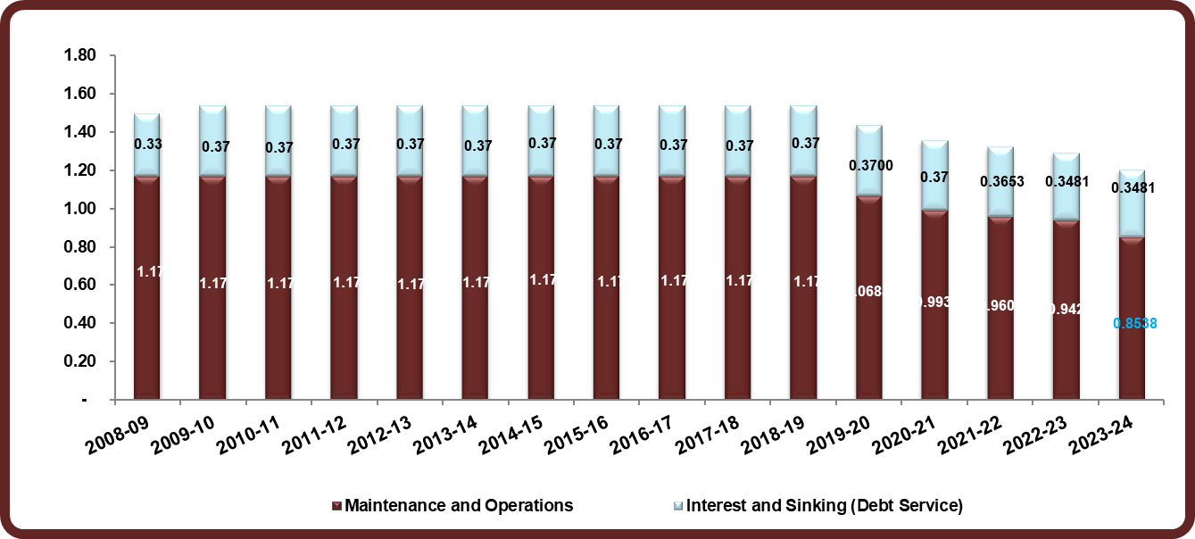
Tax Rate History

Slide 35
Principal Taxpayers

Slide 36
Agenda
2023-2024 Budget Development
2023-2024 Budget for Adoption
Discussion on Property Values
Next Steps
Questions

Slide 37
Discussion on Property Values
As part of the annual FIRST rating, information comparing the two (2) types of property values must be shared with the Board
  Locally Certified Property Values (LCPV)
    Determined by the local County Appraisal District (CAD)
    Used to project the tax collection revenue for the budget year
    Provided annually to districts at the end of July (based on the prior January)
  State Certified Property Values (SCPV)
    Goal is to ensure equitable distribution of state funding for public education
  Estimates the school district’s taxable property value (PVS) for the Foundation School Program (state funding)
  Also provides the State a means to measure the performance of the CAD
  Study conducted at least every two (2) years

Slide 38
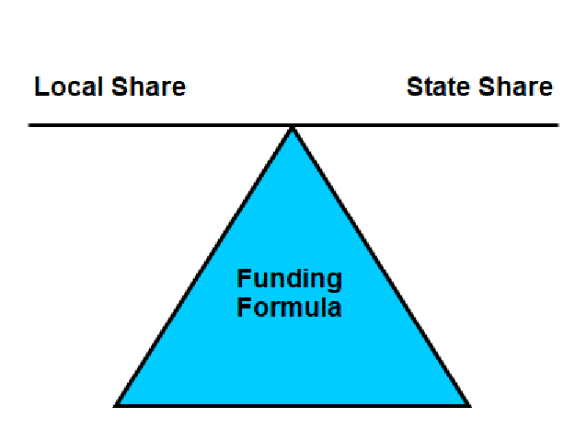
Discussion on Property Values
As the Comptroller's property value (Local Share) increases, the Foundation School Program funding (State Share) will decrease

Slide 39
Impact of Property Values

Slide 40
Agenda
2023-2024 Budget Development
2023-2024 Budget for Adoption
Discussion on Property Values
Next Steps
Questions

Slide 41
Next Steps
Ask the Board to adopt the 2023-2024 Budget
Continue to monitor the current year budget to actual revenues and expenditures
Adopt the final 2023 Tax Rate in August or September
  May also require a Budget Amendment
Monitor the activities related to any changes in the State Budget
  May negatively impact funding
  Will review current programs and prepare for reductions

Slide 42

Questions

